Slide 1

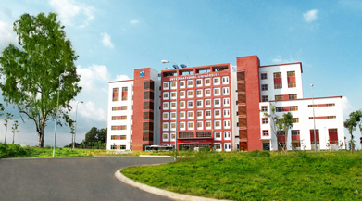
International University
MICRO-PROCESSING SYSTEM
Lecture 0C:
Introduction to Computer
Vo Minh Thanh, M.Eng
School Of Electrical Engineering

Slide 2
Topics
What is computer?
What is Microprocessor?
Internal organization of computers
  The different parts of a computer
    I/O
    Memory
    CPU
  Connecting the different parts
    Connecting memory to CPU
    Connecting I/Os to CPU
How computers work

Slide 3
What is Computer ?
Data Processing
Computer
Data Storage

Slide 4

Basic Functions of Computer
Data Processing
Data Storage
Data Movement
Control

Slide 5
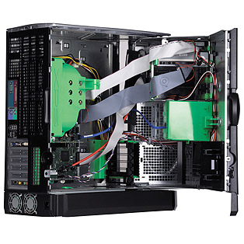
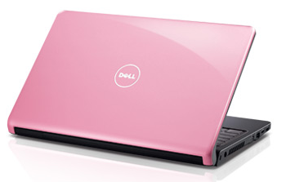
Microprocessor-Based Systems
Whenever the word microprocessor is mentioned, it conjures up a picture of a desktop or laptop PC running an application such as a word processor or a spreadsheet.
While this is a popular application for microprocessors, it is not the only one and the fact is most people use them indirectly in common objects and appliances without realizing it. Without the microprocessor, these products would not be as sophisticated or cheap as they are today.

Slide 6
Microprocessor-Based Systems
Computing systems are everywhere. Its probably no surprise that millions of computing systems are built every year destined for desktop computers (Personal Computers, or PCs), workstations, mainframes and servers. What may be surprising is that billions of computing systems are built every year for a very different purpose: they are embedded within larger electronic devices, repeatedly carrying out a particular function, often going completely unrecognized by the devices user. Creating a precise definition of such embedded computing systems, or simply embedded systems, is not an easy task.

Slide 7
Computer Classifications
Classification of computers:
  Servers:
    Big, expensive, available 24x7 (read “24 by 7” or 24 hours a day, 7 days a week. Mainframes are old servers made by IBM.
  Desktops:
    computers on your desk
  Laptops:
    computers you carry in your bag
  PDA (personal digital assistants):
    Miniaturized computers you carry in your pocket
  Embedded systems:
    computers that have a specific application!
Notes:
1-<number>

Slide 8
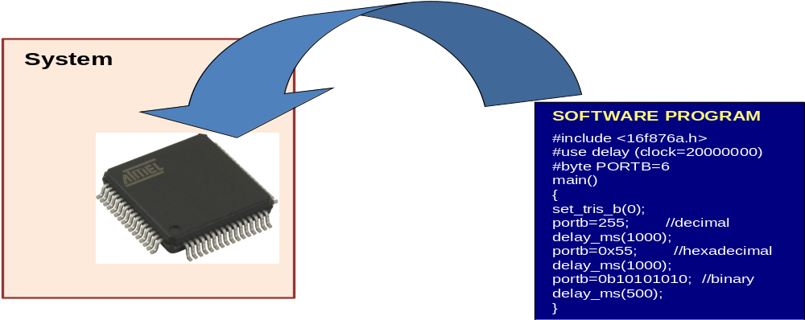
What is an Embedded System?
a microprocessor-based system
built to control a function or range of functions
not designed to be programmed by the end user in the same way that a PC is
Usually embedded as part of a complete device including hardware and mechanical parts

Slide 9
Specific Purpose Processors in Embedded Systems
Embedded Controllers:
  General purpose for any embedded system
  Small size, low power, integrated functions
  Traffic light system, SCADA system etc.
Digital Signal Processors:
  optimized for MAC operations especially for digital signal processing applications
  Commonly found in hand-phones, modems, communications systems, motor driver, CNC machines etc.
Graphics Processors:
  To speed up graphic processing such as physic calculations, image manipulation etc.
  found in graphics cards of workstations and als o integrated with a CPU
Programmable Logic Controllers:
  Optimized for control applications
  Usually found in industrial and automation applications
Notes:
1-<number>
Advantages of Microcontrollers:
Pin count down
Design time down, Board layout size down
Upgrade path easier – matching between peripherals
Cost down – bulk purchases
Reliability up
Common software / hardware design available from manufacturer

Slide 10
General Purpose Computing vs Embedded Systems
General Purpose | Embedded
Intended to run a fully general set of applications | Runs a single or limited applications often known at design time
End-user programmable | Not end-user programmable
Resources are plenty, Faster is always better | Resources are scarce, operates in fixed run-time constraints, additional performance may not be useful/valuable
Differentiating features: Speed (need not be fully predictable) Cost (eg RM3k vs RM5k per laptop) Software compatibility | Differentiating features: Speed (must be predictable) Power Cost (eg RM2 vs RM2.50) Size Software compatibility problems
Notes:
1-<number>

Slide 11
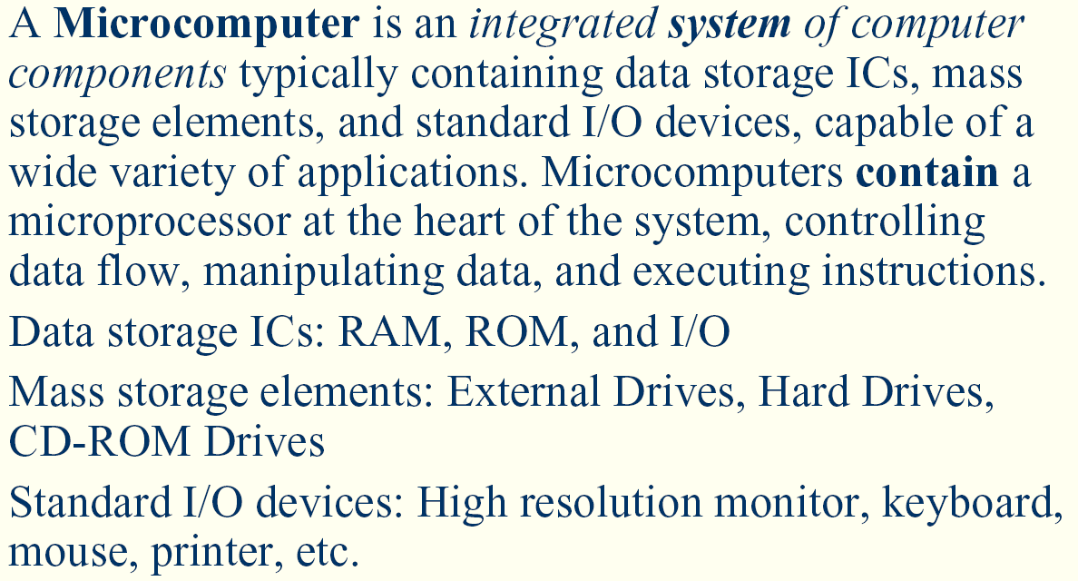
A Computer System – Simplified View
20112012-I
<number>/Module 1

Slide 12
A Computer System – Simplified View
Stores and retrieves data
Moves data between the computer
and its external environment
CPU
Memory
Input/Output
Controls the operation of the computer
Performs its data processing functions
Provides internal communication
among CPU, main memory and I/O
Address bus
Data bus
Control bus
An embedded system also has the same structure but at a smaller size
Notes:
1-<number>
Processor:
The brain of the computer
As known as the CPU (central processor unit)
Memory
Stores information
Input/Output Devices:
Gets information in & out of the computer
Buses:
Links all components

Slide 13
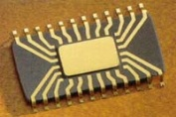
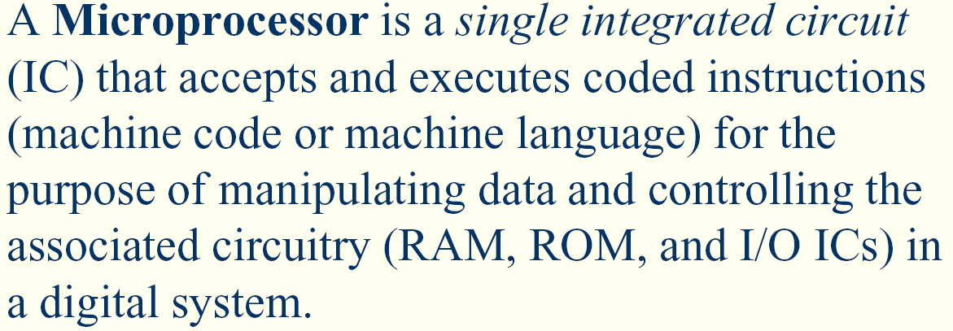
What is Microprocessor?
Central Processing Unit (CPU): Control the operation of the computer and performs its data processing functions; often simply referred to as PROCESSOR
CPU

Slide 14
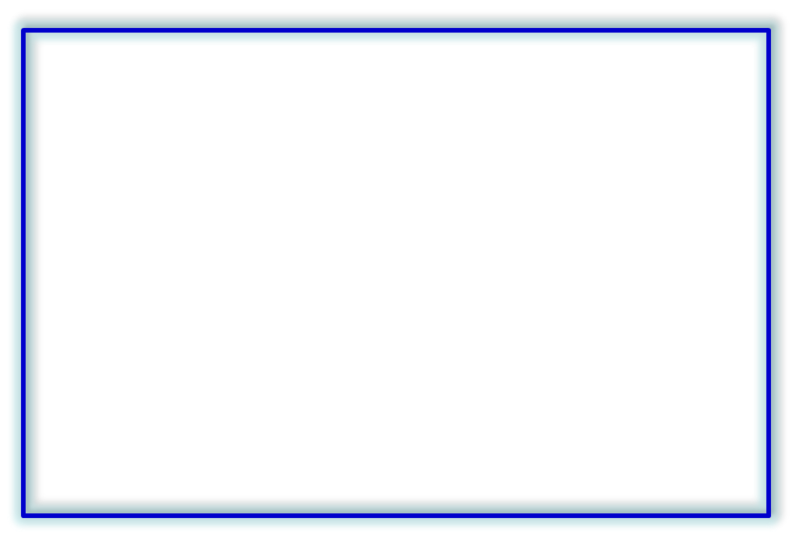
Processor or Central Processing Unit (CPU)
A set of internal storage locations within the CPU
To perform the arithmetic and logical operations within the CPU
Control & Instruction Registers
User-Visible Registers
Address Bus
Registers
Program Counter
General-Purpose Reg.
Internal Bus
Data Bus
Instruction Register
ALU
Address Register
...
Data Register
Control Unit
Control Bus
...
Flag Register
To synchronize and control the overall operation of the μP system
To decode instruction and pass the necessary control signals to CU
20112012-I
<number>/Module 1

Slide 15
Microprocessor – Basic concept
CPU
Address bus
16-bit / 32-bit / 64-bit wide
bidirectional
8-bit / 16-bit / 32-bit / 128-bit
Data bus
Timing signals, ready signals,
interrupts etc
Control bus
Microprocessor, by-itself, completely useless – must have external peripherals to Interact with outside world
Notes:
1-<number>

Slide 16
Microprocessor – Basic concept
CPU
Address
Control
Boot
ROM
Used at
startup
Instruction
(program)
ROM
Data
RAM
Input/
Output
External
Comm.
Data
Microprocessor, by-itself, completely useless – must have external peripherals to Interact with outside world
Notes:
1-<number>

Slide 17
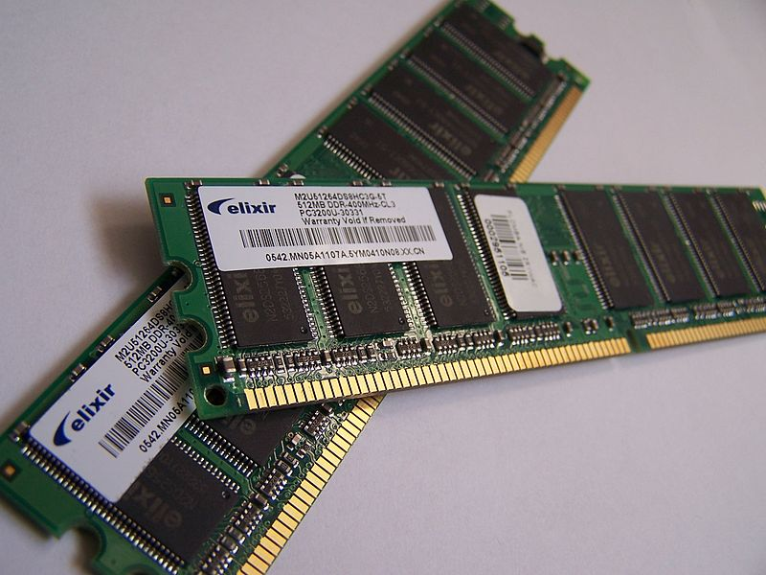
Memory
Memory Address-1 →
Memory Location-1
Memory Address-2 →
Memory Location-2
1
2
3
4
5
6
7
8
1 byte = 8-bit data
1 word= 2 bytes
1 double = 2 words
Memory Address-n →
Memory Location-n
Number of addresses 2^{N} (where N is an integer)

Slide 18
Memory Devices
Read-Only Memory
  Non-volatile memory: contents is retained even without power
  In embedded systems, used to store application programs and test routines
  Contents can be set by fixing it during manufacturing or “burning” it using a programming device
  Common types include MROM, PROM, EPROM and flash memory
  Erasable types can only be rewritten a fixed number of times
Random Access Memory
  Contents lost without power (volatile memory)
  Used to store temporary data. In embedded system, very little RAM is required. Some systems don’t even have RAM at all!
  No limit to number of writes the device can handle
  Fast writes (unlike EPROM/EEPROM)
  Two major types are SRAM and DRAM
Notes:
1-<number>
Daftar Istilah:
BM BI
Meruap volatile
Tak meruap non-volatile
Ingatan capaian rawak random access memory (RAM)
Ingatan baca sahaja read-only memory (ROM)
MROM masked ROM
PROM programmable ROM
EPROM erasable programmable ROM
EEPROM electrically-erasable programmable ROM
OTPROM one-time programmable ROM
NOVRAM non-volatile RAM

Slide 19
Data & Address Buses
Smallest transferable amount of data from memory to CPU (and vice versa) is one byte.
Each byte has a unique location or address.
The address of each byte is written in hexadecimal (hex). For AVR, the prefix ‘0x’ means a hex value.
The range of addresses accessible by the processor is the memory space. (Limited by the size of the address bus).
The Atmega32 (and many other AVR models) does not have direct support for an external memory interface.
CPU
Memory
24-bit address bus
16-bit data bus
Data bus 16 bits
15
0
0x000000
Address bus 24 bits
2
24
-1=
8M locations
0xFFFFFF
Notes:
1-<number>

Slide 20
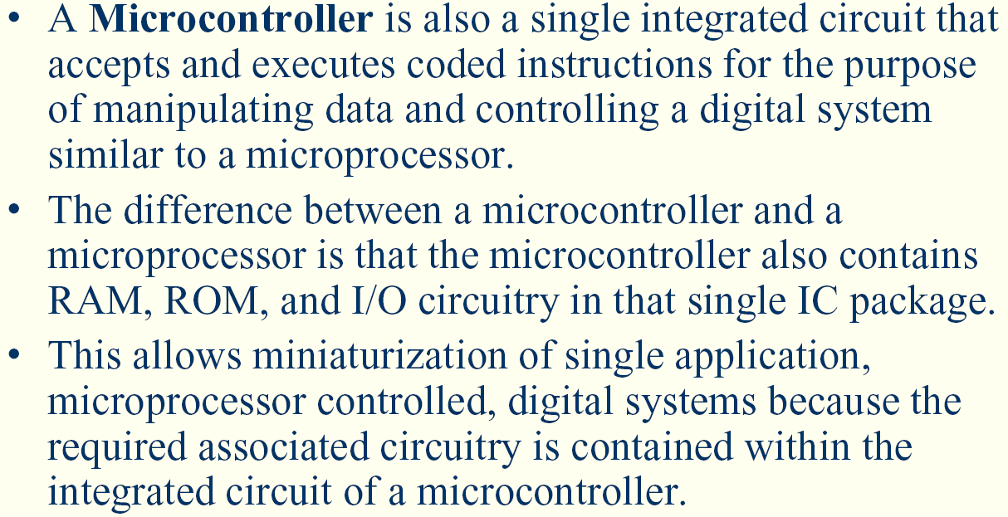
Microcontroller – Basic concept
20112012-I
<number>/Module 1

Slide 21
Microcontroller – Basic concept
CPU
Address
Control
Boot
ROM
Program
ROM
Data
RAM
Input/
Output
External
Comm.
Data
Microcontroller - put a limited amount of most commonly used resources inside one chip
Notes:
1-<number>

Slide 22
Internal organization of computers
CPU
Memory
I/O
  Input
    E.g. Keyboard, Mouse, Sensor
  Output
    E.g. LCD, printer, hands of a robot

Slide 23
Memory
Everything that can store, retain, and recall information.
  E.g. hard disk, a piece of paper, etc.

Slide 24
Memory characteristics
Capacity
  The number of bits that a memory can store.
    E.g. 128 Kbits, 256 Mbits
Organization
  How the locations are organized
    E.g. a 128 x 4 memory has 128 locations, 4 bits each
Access time
  How long it takes to get data from memory
4 bits
0
1
2
128 locations
…
127

Slide 25
Binary Prefix
Prefixes for binary multiples
Value | Pronunciation | Prefix | Origin | Derivation
2¹⁰ | kibi | Ki | kilobinary: (2¹⁰)¹ | kilo: (10³)¹
2²⁰ | mebi | Mi | megabinary: (2¹⁰)² | mega: (10³)²
2³⁰ | gibi | Gi | gigabinary: (2¹⁰)³ | giga: (10³)³
2⁴⁰ | tebi | Ti | terabinary: (2¹⁰)⁴ | tera: (10³)⁴
2⁵⁰ | pebi | Pi | petabinary: (2¹⁰)⁵ | peta: (10³)⁵
2⁶⁰ | exbi | Ei | exabinary: (2¹⁰)⁶ | exa: (10³)⁶

Slide 26
Decimal Prefix
Value | Prefix | Pronunciation
1000 | K | kilo
1000² | M | mega
1000³ | G | giga
1000⁴ | T | tera
1000⁵ | P | peta
1000⁶ | E | exa
1000⁷ | Z | zetta
1000⁸ | Y | yotta

Slide 27
Prefixes in Industry
In most other contexts, the industry uses kilo, mega, giga, etc., in a manner consistent with their meaning in the International System of Units (SI): as powers of 1000. For example, a 500 gigabyte hard drive holds 500000000000 bytes, and a 100 megabit per second Ethernet connection transfers data at 100000000 bit/s.
As of 2011 the adoption of the IEC International Standard names and symbols for prefixes for binary multiples for use in the fields of data processing and data transmission has been slow and usage has been limited in the marketplace and in the press.

Slide 28
Reality About Binary and Decimal Prefix
Faced with this reality, the IEEE Standards Board decided that IEEE standards will use the conventional, internationally adopted, definitions of the SI prefixes.
Mega will mean 1 000 000, except that the base-two definition may be used (if such usage is explicitly pointed out on a case-by-case basis) until such time that prefixes for binary multiples are adopted by an appropriate standards body.
In our course we will use the binary prefix

Slide 29
The reality of Binary Prefix Implementation
The original Decimal | Is adopted as Binary Prefix in most Computing books/manuals
Prefix | Value | Pronunciation (as from derivation)
K | 1024 | kilo
M | 1024² | mega
G | 1024³ | giga
T | 1024⁴ | tera
P | 1024⁵ | peta
E | 1024⁶ | exa
Z | 1024⁷ | zetta
Y | 1024⁸ | yotta

